Slide 1
Lecture 1 Python Basic
Jaeyun Kang

Slide 2

Python Introduction

Slide 3
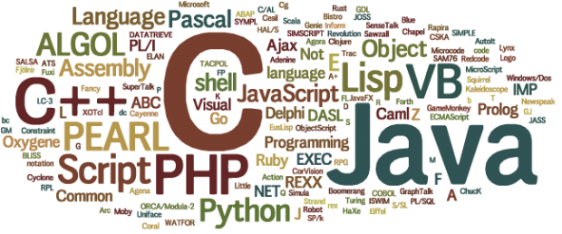
Programming Language
Common expression & grammar
Distinct philosophy

Slide 4
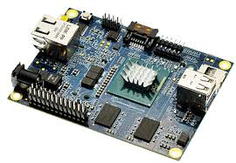

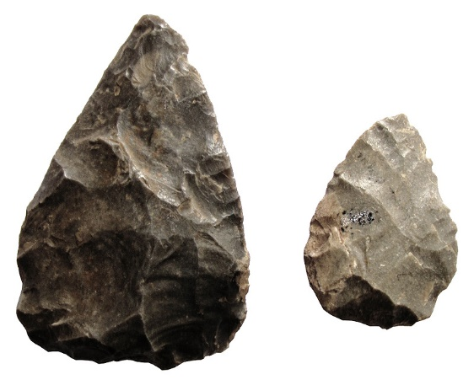

C

Slide 5
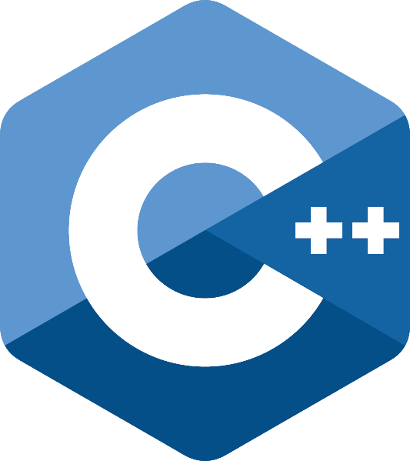




C++

Slide 6



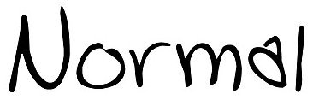


JAVA

Slide 7






Python

Slide 8
Python Basic – Print
print (“Hello, World”)
print (5.3)
print (1 + 3)
print (‘a’)
print (‘b’)
print (‘a’, ‘b’)
# print (‘a’) // tip: comment

Slide 9
Python Basic – Variables and Assigning
a = 1
print (a)
var0 = “Hello”
var1 = 10
var2 = 5
a = b = “Python”
print (a)
print (b)
a = “Python”
b = a
print (b)

Slide 10
Python Basic – Variables and Assigning
a, b = (‘python’, ‘life’)
(a, b) = ‘python’, ‘life’
[a, b] = [‘python’, ‘life’]
a = 3
b = 5
a, b = b, a // a = 5, b = 3

Slide 11
Python Basic – Variables
What can be variable names?
Combination of
alphabets a, b, c, A, B, C,…
digits 1, 2, 3,…
underbar _
Starts with lower case
Should contain meaning
Var(x), var(o)
a(x), b(x), numOfStudents(o), num_of_students(o)

Slide 12
Python Basic – Data Type Number
Integer
a = 123
a = -178
a = 0
Floating-point
a = 1.2
a = -3.45

Slide 13
Python Basic – Data Type Number
Fundamental operations
Plus : + , Minus : - , Multiply : * , Divide : /
a = 7
b = 2
print (a + b) // 9
print (a – b) // 5
print (a * b) // 14 ( print (a ** b) // 49 )
print (a / b) // 3.5 ( print (a // b) // 3 )
print (a % b) // 1

Slide 14
Python Basic – Data Type Number
a = 2
b = a * 2
print (b) // 4
a = 5
a = a + 1
print (a) // 6
a = 5
a += 1 ( a = a $ 3 -> a $= 3)
print (a) // 6
c = 10
c *= 2
print (c) // 20

Slide 15
Python Basic – Data Type String
a = “KUSITMS is alcohol”
a = ‘KUSITMS is alcohol’
a = “””KUSITMS is alcohol”””
a = ‘’’KUSITMS is alcohol’’’
a = ‘Python’s favorite food is perl!’ (x)
a = “Python’s favorite food is perl!” (o)
a = ‘Python\’s favorite food is perl!’ (o)

Slide 16
Python Basic – Data Type String
Life is too short
You need python
a = “Life is too short\nYou need python”
print (a)
a = “””
Life is too short
You need python
“””
print (a)

Slide 17
Python Basic – Data Type String
String operations
head = “Python”
tail = “ is fun”
print (head + tail) // Python is fun
a = “Python”
print (a * 2) // PythonPython
print (“=“ * 10) // ==========
print (“Python” + 2) // error
print (“Python” + str(2)) // Python2

Slide 18
Python Basic – Data Type String
String Indexing
a = “Life is too short, You need Python”
print (a[0]) // L
print (a[1]) // i
print (a[2]) // f
print (a[3]) // e
print (a[4]) // ‘ ‘
print (a[5]) // i
…
print (a[-1]) // n
print (a[-2]) // o
print (a[-0]) // L

Slide 19
Python Basic – Data Type String
String Slicing
a = “Life is too short, You need Python”
How to print Life?
print (a[0]+a[1]+a[2]+a[3]) // Life
print (a[0:4]) // Life
print (a[0:3]) // Lif
print (a[5:7]) // is
print (a[19:]) // You need Python
print (a[:17]) // Life is too short
print (a[:]) // Life is too short, You need Python
print (a[19:-7]) // You need

Slide 20
Python Basic – Data Type String
String Slicing
a = “20160930Rainy”
data = a[:8]
weather = a[8:]
print (data) // 20160930
print (weather) // Rainy
word= “Pithon”
word[1] = ‘y’ // error
newWord = word[:1] + ’y’ + word[2:]
print (newWord) // Python

Slide 21
Python Basic – Data Type String
String Formatting
a = “I eat %d apples.” % 3
print (a) // I eat 3 apples.
a = “I eat %s apples.” % “five”
print (a) // I eat five apples.
number = 3
a = “I eat %d apples.” % number
print (a) // I eat 3 apples.

Slide 22
Python Basic – Data Type String
String Formatting
number = 10
day = “three”
a = “I ate %d apples. So I was sick for %s days.” %(number, day)
// I ate 10 apples. So I was sick for three days.
%s: String, %c: character, %d: Integer, %f: floating-point

Slide 23
Python Basic – Data Type String (Functions)
a = “hobby”
print (a.count(‘b’)) // 2
a = “Python is best choice”
print (a.find(‘b’)) // 10
print (a.find(‘k’)) // -1
a = “,”
print (a.join(‘abcd’)) // a = “a,b,c,d”

Slide 24
Python Basic – Data Type String (Functions)
a = “hi”
a.upper() // a = “HI”
a = “HI”
a.lower() // a = “hi”
a = “ hi “
a.strip() // a = “hi”

Slide 25
Python Basic – Data Type List
List_name=[a1, a2, ….]
odd = [1, 3, 5, 7, 9]
a = []
b = [1, 2, 3]
c = [‘Life’, ‘is’, ‘too’, ‘short’]
d = [1, 2, ’Life’, ’is’]
e = [1, 2, [‘Life’, ’is’]]

Slide 26
Python Basic – Data Type List
List indexing
a = [1, 2, 3]
print (a) // [1, 2, 3]
print (a[0]) // 1
print (a[1]) // 2
print (a[2]) // 3
print (a[0] + a[2]) // 4
print (a[-1]) // 3

Slide 27
Python Basic – Data Type List
List indexing
a=[1, 2, 3, [‘a’, ’b’, ’c’]]
print (a[0]) // 1
print (a[-1]) // [‘a’, ‘b’, ‘c’]
print (a[-1][0]) // a
print (a[-1][1]) // b

Slide 28
Python Basic – Data Type List
List Slicing
a=[1, 2, 3, 4, 5]
print (a[0:2]) // [1, 2]
print (a[:2]) // [1, 2]
print (a[2:]) // [3, 4, 5]
a = [1, 2, 3, [‘a’, ’b’, ’c’], 4, 5]
print (a[2:5]) // [3, [‘a’, ’b’, ’c’], 4]
print (a[3][:2]) // [‘a’, ‘b’]

Slide 29
Python Basic – Data Type List
List Operation
a = [1, 2, 3]
b = [4, 5, 6]
print (a + b) // [1, 2, 3, 4, 5, 6]
a = [1, 2, 3]
print (a * 3) // [1, 2, 3, 1, 2, 3, 1, 2, 3]

Slide 30
Python Basic – Data Type List
List Modification
a = [1, 2, 3]
a[2] = 4
print (a) // [1, 2, 4]
a = [1, 2, 3]
a[1:2] = [‘a’, ‘b’, ‘c’]
print (a) // [1, ‘a’, ‘b’, ‘c’, 3]
a = [1, 2, 3]
a[1] = [‘a’, ‘b’, ‘c’]
print (a) // [1, [‘a’, ‘b’, ‘c’], 3]

Slide 31
Python Basic – Data Type List
List Deletion
a = [1, ‘a’, ‘b’, ‘c’, 3]
a[1:3] = []
print (a) // [1, ‘c’, 3]
a = [1, ‘c’, 3]
del a[1]
print (a) // [1, 3]
a = [1, 2, 3]
del a[1:3]
print (a) // [1]

Slide 32
Python Basic – Data Type List (Functions)
a = [1, 2, 3]
a.append(4) // a = [1, 2, 3, 4]
a.append([5, 6]) // a = [1, 2, 3, 4, [5, 6]]
a = [1, 4, 3, 2]
a.sort() // a = [1, 2, 3, 4]
a = [‘a’, ‘c’, ‘b’]
a.sort() // a = [‘a’, ‘b’, ‘c’]

Slide 33
Python Basic – Data Type List (Functions)
a = [1, 2, 3, 4]
a.reverse() // a = [4, 3, 2, 1]
a = [1, 2, 3]
print (a.index(3)) // 2
print (a.index(1)) // 0
print (a.index(0)) // error

Slide 34
Python Basic – Data Type List (Functions)
a = [1, 2, 3]
a.insert(0, 4) // a = [4, 1, 2, 3]
a.insert(3, 5) // a = [4, 1, 2, 5, 3]
a = [1, 2, 3, 1, 2, 3]
a.remove(3) // a = [1, 2, 1, 2, 3]
a.remove(3) // a = [1, 2, 1, 2]

Slide 35
Python Basic – Data Type List (Functions)
a = [1, 2, 3]
a.pop() // a.pop() = 3, a = [1, 2]
a = [1, 2, 3]
a.pop(1) // a.pop(1) = 2, a = [1, 3]
a = [1, 2, 3, 1]
print (a.count(1)) // 2

Slide 36
Python Basic – Data Type Tuple
t1 = ()
t2 = (1,)
t3 = (1, 2, 3)
t4 = 1, 2, 3
t5 = (‘a’, ‘b’, (‘ab’, ‘cd’))
t1 = (1, 2, ‘a’, ‘b’)
del t1[0] // error
t2 = (1, 2, ‘a’, ‘b’)
t2[0] = ‘c’ // error
Indexing / Slicing / Operations are supported like list

Slide 37
Python Basic – Data Type Dictionary
{Key1: Value1, Key2: Value2, Key3: Value3 …}
dic = {‘name’: ’pey’, ‘phone’: ’01068631342’, ‘birth’: ’1118’}
a = {1: ’hi’}
a = {‘a’: [1, 2, 3]}

Slide 38
Python Basic – Data Type Dictionary
a = {1: ’a’}
a[2] = ‘b’ // a = {2: ‘b’, 1: ’a’}
a[‘name’] = ‘pey’ // a = {‘name’: ’pey’, 2: ’b’, 1: ’a’}
a[3] = [1, 2, 3] // a= {‘name’: ’pey’, 3: [1, 2, 3], 2: ’b’, 1: ’a’}
del a[1] // a= {‘name’: ‘pey’, 3: [1, 2, 3], 2: ’b’}

Slide 39
Python Basic – Data Type Dictionary
a = {1: ’a’, 2: ’b’}
print (a[1]) // a
print (a[2]) // b
grade = {‘pey’: 10, ‘Juliet’: 99}
print (grade[pey]) // error
print (grade[‘pey’]) // 10
print (grade[‘Juliet’]) // 99

Slide 40
Python Basic – Data Type Dictionary
Key should be distinct value
a = {1: ’a’, 1: ’b’}
print (a) // {1: ’b’}
Cannot use lists for keys
a = {[1, 2]: ’hi’} // error

Slide 41
Python Basic – Data Type True & False
There is ‘Boolean’ data type
a = True
b = False (Capital)
print (a)
Boolean operator : and, or, not
not True // False
not False // True
True and True // True
True and False // False
False and False // False
True or True // True
True or False // True
False or False // False

Slide 42
Python Basic – Data Type True & False
a = False
b = True
print (not (a and b)) // True
Boolean operator priority : ( ) > not > and > or
c = not False or True and False
print (c) // True

Slide 43
Python Basic – Data Type True & False
Comparing Operator : >, <, >=, <=, ==, !=
a = 2 ; b = 3
print (a > b) // False
print (a < b) // True
a = 2 ; b = 2
print (a == b) // True
print (a != b) // False
a = 5
print (a >= 3) // True
print (a == 5) // True
c = (a > 6)
print (c) // False

Slide 44
Python Basic – Data Type True & False
Other Data type also can be True or False
String
True: “python”
False: “”
List
True: [1,2,3]
False: []
Number
True: not 0
False: 0

Slide 45
Python Basic – Control Statement if, else, elif
if (Boolean condition):
statement1
…
else:
statement2
…
money = 9000
if money > 10000:
print (“taxi”)
else:
print (“bus”) // bus

Slide 46
Python Basic – Control Statement if, else, elif
a = 17
if a % 2 == 0:
print (“Even”)
else:
print (“Odd”) // Odd
a = 20
if a > 10 and a != 30:
print (“yes”) // yes
else:
print (“no”)

Slide 47
Python Basic – Control Statement if, else, elif
if 1 in [1, 2, 3]:
print (“yes”) // yes
else:
print (“no”)
if ‘j’ not in ‘python’:
print (“yes”) // yes
else:
print (“no”)

Slide 48
Python Basic – Control Statement if, else, elif
a = 20
if a > 10 and a != 30:
pass // Nothing happened
else:
print (“no”)
a = 17
if a % 2 == 0: print (“Even”)
else: print (“Odd”) // Odd

Slide 49
Python Basic – Control Statement if, else, elif
a = 10
if a > 5
print (“yes”)
else
print (“no”) // Error
a = 10
if a > 5:
print (“yes”)
else:
print (“no”) // Error
Notice : Don’t forget ‘ : ’ & Tap

Slide 50
Python Basic – Control Statement if, else, elif
if (Boolean condition):
statement
…
elif (Boolean condition):
statement
…
elif (Boolean condition):
statement
…
else:
statement
…

Slide 51
Python Basic – Control Statement if, else, elif
grade = 76
if grade >= 90:
print (“A”)
elif grade >= 80:
print (“B”)
elif grade >= 70:
print (“C”) // C
elif grade >= 60:
print (“D”)
else:
print (“F”)

Slide 52
Python Basic – Control Statement if, else, elif
grade = 86
if grade >= 90:
if grade >= 95:
print (“A+”)
else:
print (“A0”)
elif grade >= 80:
if grade >= 85:
print (“B+”) // B+
else:
print (“B0”)
else:
print (“F”)

Slide 53
Python Basic – Control Statement while
while (Boolean condition):
statement1
statement2
…
i = 1
while i <= 10:
print (i)
i = i + 1 // 1 2 3 4 5 6 7 8 9 10
Also don’t forget ‘ : ’ & Tap

Slide 54
Python Basic – Control Statement while
a = 1
while a < 10:
a = a * 2
print (a) // 16
a = [‘x’, ‘y’, ‘z’, ‘w’]
i = 0
while i < 4:
print (a[i])
i = i + 1 // x y z w

Slide 55
Python Basic – Control Statement while (Continue & Break)
a = 1
while True:
a = a + 1
if a >= 100:
break
print (a) // 100
lis = [‘a’, ‘b’, ‘c’, ‘d’]
i = -1
while i < 3:
i = i + 1
if lis[i] == ‘c’:
continue
print (lis[i]) // a b d

Slide 56
Python Basic – Control Statement for
for (variable) in (list_name):
statement1
statement2
…
test_list = [‘one’, ‘two’, ‘three’]
for i in test_list:
print (i) // one two three

Slide 57
Python Basic – Control Statement for
marks = [90, 25, 67, 45, 80]
number = 0
for mark in marks:
number = number + 1
if mark >= 60:
print (str(number) + “ student is passed”)
else:
print (str(number) + “ student is failed”)
// 1 student is passed
// 2 student is failed
// 3 student is passed …

Slide 58
Python Basic – Control Statement for
sum = 0
for i in range(1, 11):
sum = sum + i
print (sum) // 55
for i in range(5):
print (i) // 0 1 2 3 4

Slide 59
Python Basic – Control Statement for
marks = [90, 25, 67, 45, 80]
for number in range(len(marks)):
if marks[number] < 60: continue
print (str(number+1) + “ student is passed”)
// 1 student is passed
// 3 student is passed
// 5 student is passed
for i in range(2, 10):
for j in range(1, 10):
print (i * j, end = “ “)
print (“”) // ?

Slide 60
Exercise 1
Print below pattern
*
**
***
****
*****

Slide 61
Exercise 2
Calculate average of student’s score
[70, 60, 55, 75, 95, 90, 80, 80, 85, 100]
Answer: 79.0

Slide 62
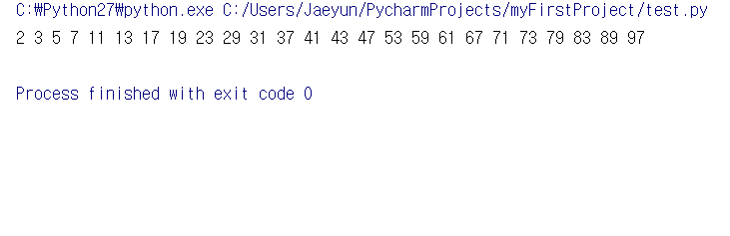
Exercise 3
Print all prime number p<=100
Prime number: 2, 3, 5, 7, 11, 13, 17…

Slide 63
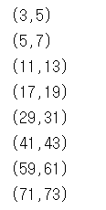
Exercise 4
Print all twin-prime number pair (p1, p2) p2<=100
twin-prime number (p1, p2):
both p1, p2 are prime numbers and p2 = p1 + 2
twin-prime number: (3, 5), (5, 7), (11, 13), (17, 19) …

Slide 64
Exercise 5
Make program which print binary notation of number 925
(925 is in decimal notation)
Ex) binary notation of number 3 : 11
Ex) binary notation of number 5 : 101
Ex) binary notation of number 7 : 111
Ex) binary notation of number 17 : 10001
Hint:
a = []
a.append(3) // a = [3]
a.append(4) // a = [3, 4]
a.reverse() // a = [4, 3]

Slide 65
Question

